Slide 1
Lecture: Transport Layer Security (secure Socket Layer)
Recommended reading:
Stephen Thomas, “SSL and TLS essentials”, Wiley, 2000
Very old and in some parts obsolete, but very well written

Slide 2
Lecture’s twofold goal
Dissection of well known and widely employed security protocol
Rasonable in-depth analysis of TLS details
Devil is in details ☺
Although many more details had to be skipped (this is not a full course on TLS…)
Understand how a long-to-live security protocol should be designed
Show good design choices vs bad ones
TLS shows several examples for both!

Slide 3
Introduction to TLS

Slide 4
History of SSL/TLS
SSL v1
by Netscape
never released
1994
SSL v2
Integrated in
netscape 1.1
Badly broken!
SSL v3
Redesigned from scratch
by Netscape
…
1995
1996
TLS v1.0
First IETF design (versus Netscape) 1996-1999
RFC 2246, jan 1999
TLS v 1.1
RFC 4346 Apr 2006
DTLS
RFC 4347 Apr 2006
UDP support
TLS v 1.2
RFC 5246
Aug 2008
Get rid of weak
MD5/SHA-1hash
(negotiated PRF,
default SHA-256)
TLS v 1.3
RFC 8446
Aug 2018
Three-way handshake! Only AEAD ciphers
Major differences
(a «new» protocol?!)
…
TLS1.0=SSLv3.1
Public Domain implementation available @ www.openssl.org

Slide 5
SSL/TLS: layered view
HTTP
SMTP
……
HTTP
SMTP
……
https
smtps
TCP/UDP/ANY
SSL/TLS
IPsec
TCP (if UDP, then DTLS)
IP
IP
Network layer security
Transport layer security
SSL/TLS: on top of TCP, but below application layer
(can be considered as top sublayer for L4 or bottom for L7)
SSL/TLS: NOT a security enhancement of TCP!
Not necessarily limited to Internet transport (L4)!
Devised for point-to-point relationships in general
E.g. EAP-TLS (RFC 2716)
TLS-based authentication and integrity protection over L2 EAP

Slide 6
Application support
Bad historical idea: reserve special port number for HTTP over SSL/TLS
HTTP=80, HTTPS=443
But what if TLS used for other applications? Special port # here as well!
smtps 465 (MS) or 587 (others)
spop3 995
imaps 991
telnets 992
…
Pros
works well; de facto standard
Straightforward application support!!
Cons:
2 reserved port numbers for same service
deprecated by IETF (but still here…)
Alternative approach: slightly adapt application’s internals
App reuses same port number
Example: HTTPv1.1: upgrade: TLS/1.0 new http command (see RFC 2817)
HTTP
SMTP
HTTP
http
80
smtp
25
TLS
TLS
http
80
https
443
smtps
587
TCP/IP

Slide 7
Compare with IPsec (e.g. AH)…
0
3
7
15
31
Version
Header
length
Type of Service
(DSCP+ECN)
Total Length
16 bit identification
flags
3 bit
13 bit fragment offset
Time to Live
TTL
Protocol=51
Header checksum
32 bit source IP address
32 bit destination IP address
Variable, if any
Options (if any)
Next Header
AH Payload length
(SN+ICV in 32 bit w)
RESERVED (all 0)
Security Parameters Index (SPI)
Sequence Number field
AH
len
Integrity Check Value (ICV)
variable
DATA (if tunnel mode: IP header + DATA) (if transport mode: TCP, UDP, other)

Slide 8
TLS Goals
Establish a session (TLS Handshake phase)
Agree on algorithms
Share secrets
Perform authentication
Transfer application data
Communication privacy
Symmetric encryption
Data integrity
Keyed Message Authentication Code (HMAC)
TLS approach: two-in-one
Other Internet security protocols may clearly distinguish the protocol for establishing a session (e.g., IPsec IKE) from the protocol that delivers data and enforces security services (e.g., IPsec ESP/AH)

Slide 9
TLS protocol stack
HTTP, etc
Trivial protocols!
Error Handling
start cipher
Establishes session &
Initializes communicaton
Handshake Protocol
Alert Protocol
Change Cipher
Spec
Application on TLS
Minor modification of apps may be necessary (e.g. see RFC 2817/2818 for
HTTPS #443
HTTPv1.1 ext
TLS Record Protocol
Data transfer
Possibly special app port#
TCP

Slide 10
TLS Record Protocol (up to TLSv1.2 – v1.3 differs!)

Slide 11
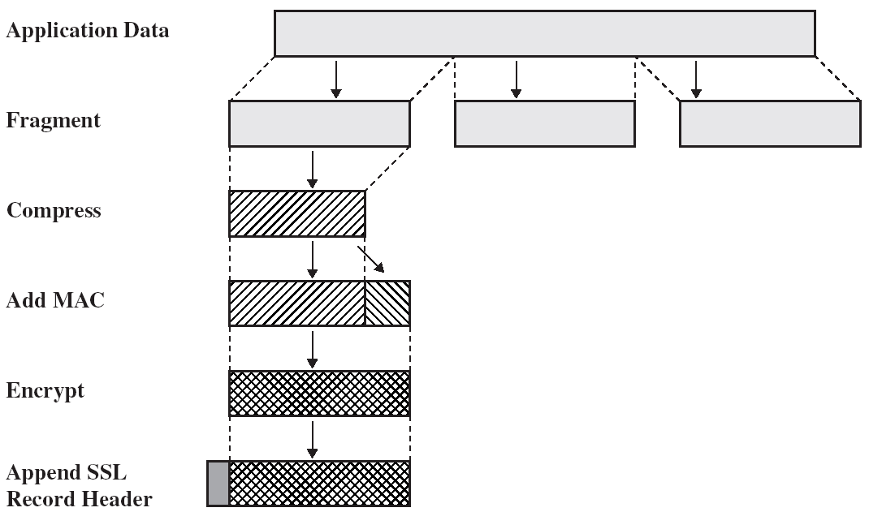

Record Protocol operation
WARNING: this slide contains TWO
MAJOR MISTAKES!!

Slide 12
Fragmentation
At application ←→TLS interface
DON’T get confused with TCP segmentation!!
Input: block message of arbitrary size
possibly multiple aggregated messages of SAME protocol
Fragment size: 2¹⁴=16384 bytes

Slide 13
Compression
Lossless compression
Formerly used in SSLv2
Considered in TLSv1.0 but not specified
«null» compression method in SSLv3 and TLSv1.0
2004, RFC 3749: introduces DEFLATE (RFC 2951)
RFC 3943 – support for Lempel-Ziv-Stac
More recently: considered appealing
Widespread diffusion of “verbose” languages – e.g. XML
@ early 2012:
45% of the browsers (including Chrome & Firefox)
42% of the servers
Suddenly died ☺ in september 2012
CRIME attack, more later

Slide 14
Message Authentication Code
MAC computation
Secret (symmetric) key derived from security parameters negotiated during handshake
Hash function: negotiated during handshake
Computation: uses HMAC construction
keyed-hashing Message Authentication, RFC 2104
message
HMAC

Slide 15
Encryption
Fragment Encryption
Applies to both (compressed) fragment and MAC
No encryption possible
If no encryption negotiated
Or in early handshake phases
Symmetric encryption algorithm
Block or stream cipher
Algorithm (RC4, 3DES, AES, etc) negotiated during handshake, too
If block cipher, padding necessary to achieve block size
Secret key derived from security parameters negotiated during handshake
Differs from key used in MAC
Encryption algorithm CANNOT increase size of more than 1024 bytes

Slide 16
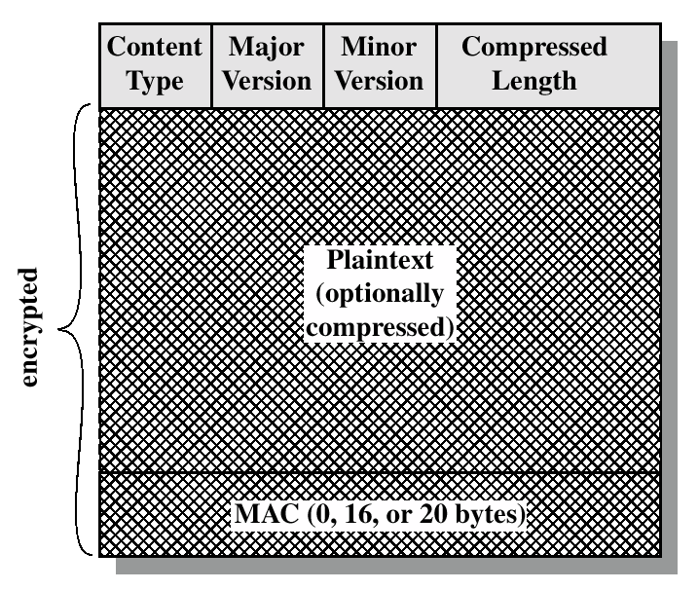
Record Protocol Data Unit
Application data OR Alert OR Handshake OR Change_cipher_spec
3.1 for TLS
5 bytes header
Content type = 1
Version = 1+1
Length = 2
Content Type
higher layer protocol
20 = 0x14 = Change Cipher Spec
21 = 0x15 = Alert
22 = 0x16 = Handshake
23 = 0x17 = Application Data
or ++

Slide 17


What about replay?
I really want to pay 2000$
Pay 1000 $
HMAC
Pay 1000 $
HMAC
I want to pay 1000$
Pay 1000 $
HMAC
Pay 1000 $
HMAC
But I’ll make you pay twice!

Slide 18
Sequence numbers
Client
C_seqnum
Server
S_seqnum
kept at both connection extremes
Distinct per-direction
Initialized to 0; up to 2⁶⁴-1; do NOT wrap
Not transmitted
Remember: reliable transport, hence no “holes”
Aftermath: NO WAY TO AVOID TCP!
Explicit 2+6=8 bytes sequence number added in DTLS

Slide 19
MAC generation details
Not TX!!!
Sequence number
TLS record header
Content type | version | length
DATA
HMAC-XXX (MD5/SHA-1 up to TLS1.0; SHA-256 default TLS1.2)
Negotiation may decide not to use MAC
In practice, always present
Sequence number:
Not transmitted but included in the MAC
to detect missing/extra data
and to prevent replay/reordering attacks

